Slide 1
Tutorial 2
Using calculator

Slide 2
ILOs – Day 13 (Tutorial 2)
Use calculator for complex number calculations

Slide 3
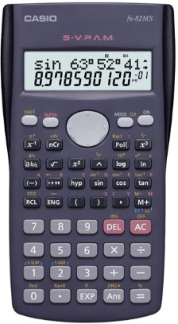
CASIO fx-82MS
Make sure to put the mode in Deg (degree)
M D
0

Slide 4
CASIO fx-82MS
Rectangular to polar conversion
Z = 2 + j3
= 3.606∠56.31⁰
Pol(2,3)
3.605551275
Pol(
F
56.30993247
Pol(2
Pol(2,
Pol(2,3
Pol(2,3)
F_
3.605551275
Step 7: ALPHA
Magnitude c = 3.606
Step 1: Pol(
Angle θ = 56.31⁰
Step 8: F
Step 3: ,
Step 5: )
Step 2: 2
Step 4: 3
Step 9: =
Step 6: =

Slide 5
CASIO fx-82MS
Polar to Rectangular conversion
Z= 3.606∠56.31⁰
= 2 + j3
Step 0: Shift
Step 7: ALPHA
Real part a ≈ 2
Step 1: Rec(
Imaginary part b ≈ 3
Step 8: F
Step 3: ,
Step 5: )
Step 2: 3.606
Step 4: 56.31
Step 9: =
Step 6: =

